Slide 1
TECHTREK · DATA SCIENCE & AI TRACK TEAM 44
Delivery Delay Prediction
A Machine Learning approach to flagging late deliveries before they happen
1
2
3
4
5
Ziad Adel
Rana Mohammed
Reem Naji
Rowan Ali
Rawan Alsir
Notes:
Welcome everyone. We're presenting our TechTrek Data Science project: predicting delivery delays for a Brazilian e-commerce platform. Quick intro of the 5 of us and what we'll cover today.

Slide 2
THE CHALLENGE
PRESENTER 1
Problem & Motivation
E-commerce customers expect reliable delivery windows — late orders erode trust and drive complaints.
Logistics teams typically find out about a delay only after it happens, when it's too late to act.
Predicting delay risk in advance lets a business intervene early: re-route, re-communicate, or reprioritize.
Why it matters
1
Customer satisfaction
2
Operational efficiency
3
Courier performance visibility
4
Data-driven planning
Problem & Motivation
2
Notes:
Set up the problem: late deliveries hurt customer trust and cost logistics teams money and time. Explain that today most delay detection is reactive — you find out after the fact. We wanted to see if we could predict it in advance using data already available before the order ships.

Slide 3
GOAL
PRESENTER 1
Project Objective
Predict whether an order will be delivered LATE — before it happens.
Task Type
Target
Business Purpose
Supervised binary classification (Late vs. On-Time)
is_late — 1 if actual delivery days exceed expected days, else 0
Flag high-risk orders early to support proactive logistics decisions
Project Objective
3
Notes:
State the objective plainly: this is a binary classification problem — will this order be late or not. Define the target briefly and connect it back to the business purpose: catching risk early enough to act on it.

Slide 4
FOUNDATION
PRESENTER 1
Dataset
Source: Brazilian E-Commerce Public Dataset (Olist) — orders, customers, products, sellers, couriers, delivery, and revenue data merged into one table.
Final modeling dataset: 113,314 orders after selecting leakage-safe columns and dropping missing values.
Split 80/20 (stratified) into train and test sets to preserve the late/on-time ratio in both.
Modeling rows
113,314
90,651
Train rows
22,663
Test rows
Dataset
4
Notes:
Introduce the dataset: Brazilian e-commerce (Olist) data covering orders, customers, products, couriers, and delivery outcomes. Mention the final modeling size — about 113K orders — and the 80/20 stratified train/test split, which keeps the same proportion of late orders in both sets.

Slide 5
INPUTS & OUTPUT
PRESENTER 1
Features & Target
8 Input Features (pre-delivery only)
TARGET
is_late
courier
expected_days
1 = delivered late · 0 = on time
weather
season
area
category
Excluded to prevent leakage
actual_delivery_days
delivery_status
order_month
order_hour
These fields directly reveal the delivery outcome, so they were kept out of training.
Features & Target
5
Notes:
Walk through the 8 features used and explain they're all things known before delivery happens — no peeking at the outcome. Point out the two excluded columns and explain briefly why they'd leak the answer if included.

Slide 6
PIPELINE
PRESENTER 1
Project Workflow
Data
→
Preprocessing
→
Feature
Engineering
→
Train/Test
Split
→
Models
→
Evaluation
→
Business
Insights
One connected pipeline: raw Olist data flows through cleaning and feature engineering into a stratified split, seven candidate models, evaluation on held-out data, and finally business-facing recommendations.
Project Workflow
6
Notes:
Show the workflow diagram and narrate it left to right: raw data goes through preprocessing and feature engineering, gets split, feeds into multiple models, gets evaluated, and finally turns into business insights. This is the throughline for the rest of the talk.

Slide 7
GETTING THE DATA READY
PRESENTER 2
Data Preprocessing
Data Audit
Cleaning
Encoding
Checked schema, missing values, and duplicate rows before any changes.
Standardized column names to snake_case; fixed mislabeled date columns; converted dates to datetime and columns to correct numeric/categorical types.
OneHotEncoder for courier / weather / season; TargetEncoder for high-cardinality area / category.
Scaling
Train/Test Split
StandardScaler applied to numeric features (expected_days, order_month, order_hour).
80/20 stratified split (random_state=42) to keep the late-order ratio consistent in both sets.
Data Preprocessing
7
Notes:
Hand off to preprocessing. Briefly explain the audit (checking missing values and duplicates), cleaning (standardizing names and types), and then the encoding/scaling approach — one-hot for low-cardinality categories, target encoding for high-cardinality ones like area and category, and scaling for numeric features. Mention the stratified split again briefly.

Slide 8
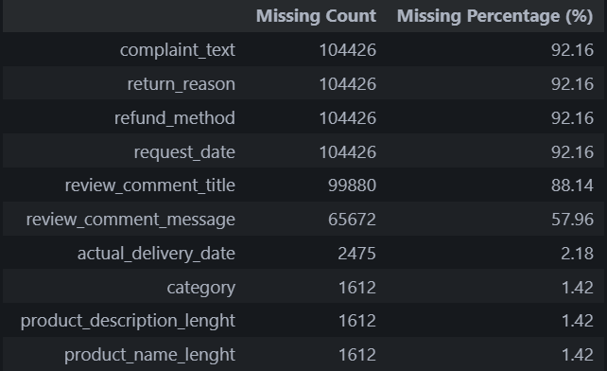
Top 10 Missing values columns
Data Audit & Quality Checks
Example for Imputation:
refund_method had NaN
This means that we dont need to drop it, because logically there were no refund reason at all, so we filled it with None instead of NaN
Same for complaint_text There were no complaint, so we filled it with None instead of NaN

Slide 9
Duplicates and Hidden nulls
Data Audit & Quality Checks
Hidden Nulls example:
'NA', 'N/A', 'Null', '-', 'null', ' ', ''
We found out that there we no duplicates in our dataset:
--- 4. DUPLICATES ---
Exact row duplicates: 0
Rows with a duplicate Order_ID: 24920
--- 5. HIDDEN NULLS ---
Found hidden nulls in the following columns:
- review_comment_title: 3 hidden nulls
- review_comment_message: 33 hidden nulls
We found some hidden nulls:
--- 5. HIDDEN NULLS ---
Found hidden nulls in the following columns:
- review_comment_title: 3 hidden nulls
- review_comment_message: 33 hidden nulls

Slide 10
Feature Engineering — Preprocessing Notebook
1. Revenue
gross_revenue = unit_price × quantity
Auto-detects discount format (% vs decimal) before calculating discount_amount
net_revenue = gross_revenue − discount_amount
2. Delivery
delivery_delay = full date subtraction (actual − expected), then .dt.days
is_late = 1 if delivery_delay > 0, else 0
3. Pricing
price_gap = unit_price − competitor_price
is_pricier = 1 if price_gap > 0, else 0
4. Time
Extracted order_month, order_weekday, order_hour from order_date
is_weekend = 1 if weekday is Saturday/Sunday (5,6)
5. Customer
age_group = binned age into 6 categories (U18, 18-25, 26-35, 36-45, 46-55, 55+)
6. Stock
low_stock_flag = 1 if stock ≤ 10th percentile of stock levels

Slide 11
: Feature Encoding Strategy
Idea: We used two different encoding methods based on the cardinality (number of unique values) of each categorical column.
1. One-Hot Encoding — for low-cardinality columns
Columns: courier (3 values), weather (3 values), season (4 values)
Each value becomes a separate binary column (0/1)
Suitable because the number of values is small and won't create too many columns.
2. Target Encoding — for high-cardinality columns
Columns: area (27 values), category (74 values)
Each value is replaced with a single number = the average target (is_late) associated with it.
Example: an area appeared 500 times, 150 were late → encoded value = 0.30
Used instead of One-Hot to avoid creating 101 extra columns and a sparse matrix.
Risk: Target Leakage
Target Encoding uses the target itself in its calculation.
If computed once on the whole dataset → data leakage.
Solution Applied
build_preprocessor() returns a fresh, unfitted copy every time it's called.
Each CV fold is fit only on its own training data, then applied to the validation data.
Result: fair evaluation with no leakage.
Final Result: 15 features after encoding (3 numerical + 10 One-Hot + 2 Target Encoded).

Slide 12
Feature Scaling
StandardScaler applied to numerical columns: expected_days, order_month, order_hour
Transforms values to mean = 0, std = 1 → keeps large-range features from dominating the model
Critical for scale-sensitive models (Logistic Regression, KNN, SVM,); optional for tree-based models
Fit only on training data per CV fold (via build_preprocessor()) → no data leakage
Train/Test Split
What Happened:
Data split into 80% Training / 20% Testing (test_size=0.2)
random_state=42 → ensures the same split every time the code runs (reproducibility)
stratify=y → preserves the same late/on-time ratio in both Train and Test sets
Why Stratify Matters Here:
The dataset has class imbalance (fewer late orders than on-time ones)
Without stratification, the late-order ratio could differ between Train and Test → unfair evaluation
With stratification, both sets reflect the same real-world proportion of delays
Result: A fair, reproducible split where the model is trained and tested on data with consistent class distribution

Slide 13
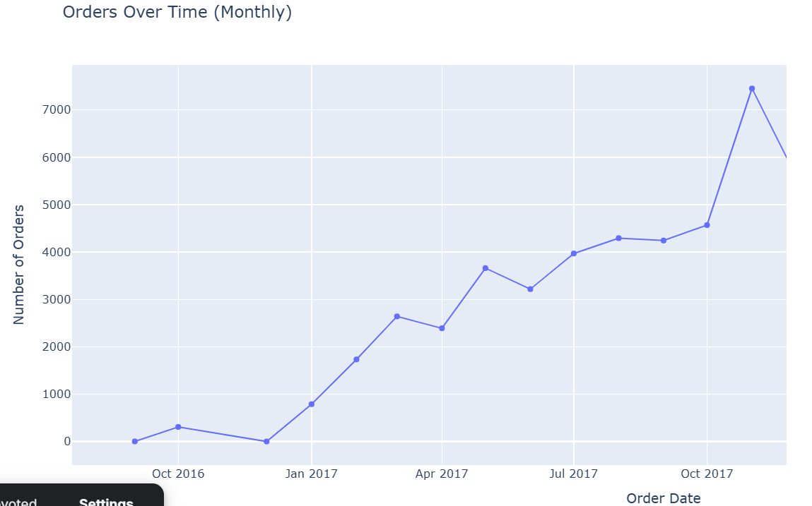
EXPLORATION 3 OF 4
PRESENTER 2
Orders Over Time (Monthly)
Order volume grew steadily from late 2016 through 2017, peaking around ~7,400 orders in November 2017.
This growth trend matters for the model: order_month is later confirmed as a top predictive feature.
Data Preprocessing & Exploration
10
Notes:
This line chart tracks monthly order volume over time, growing steadily and peaking around November 2017. Flag that this growth pattern is part of why order_month later turns out to matter to the model.

Slide 14
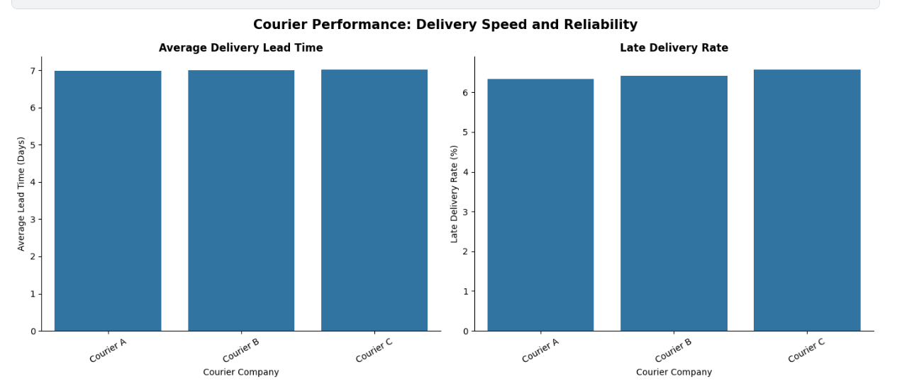
Business Insight
All three couriers (A, B, C) have nearly identical average delivery time (~7 days) and late delivery rate (~6%) — no clear performance difference between them.
Action & Limitation
Don't rely on switching couriers to fix delays; the gap is negligible and the data was partly simulated, so it may not reflect real-world performance.

Slide 15
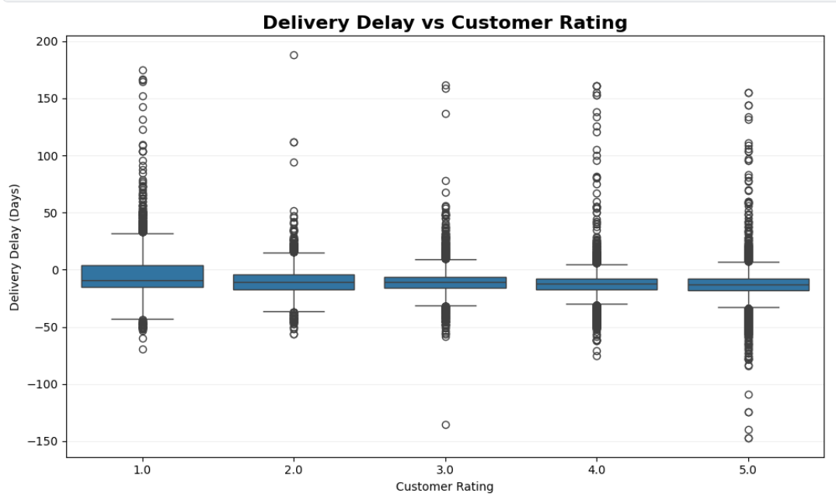
Customers who gave a Rating of 1 experienced higher delivery delays, suggesting that delays are associated with lower customer satisfaction.
Reducing severe delays and detecting them early can help improve customer satisfaction.

Slide 16
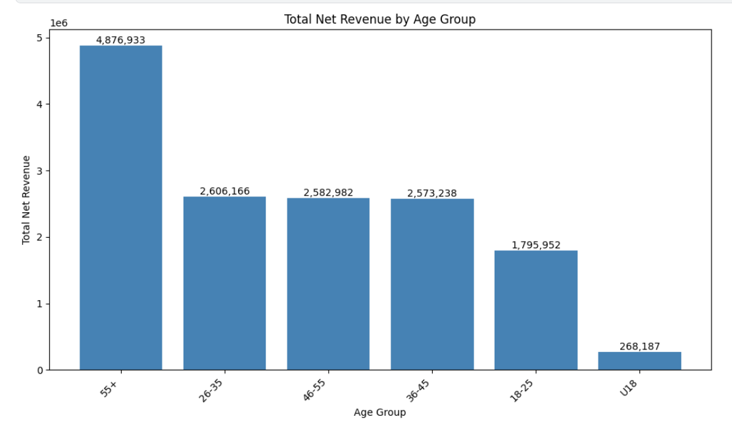
EXPLORATION 2 OF 4
PRESENTER 2
Total Net Revenue by Age Group
The 55+ age group generates the highest total net revenue (~4.9M), well above every other bracket.
26–55 age groups sit close together (~2.6M each); under-18 customers contribute the least (~268K).
Data Preprocessing & Exploration
9
Notes:
This chart shows total net revenue by age group. The 55+ segment stands out well above the others, while under-18 customers contribute the least. Useful context for who the platform's core customers are.

Slide 17
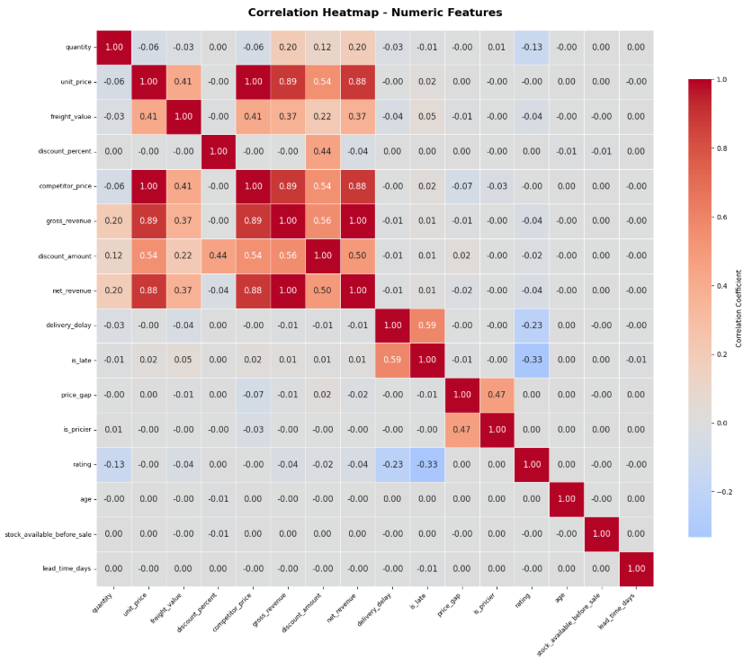
EXPLORATION 4 OF 4
PRESENTER 2
Correlation Heatmap — Numeric Features
is_late correlates most with delivery_delay (0.59, by construction) and negatively with rating (-0.33).
Revenue/price numeric fields show near-zero correlation with is_late — supporting reliance on operational and time-based features instead.
Data Preprocessing & Exploration
11
Notes:
This heatmap shows correlations between numeric features. Point out that is_late correlates with delivery_delay (expected, since it's derived from it) and negatively with rating, but has almost no correlation with price/revenue fields — which is part of why we relied on operational and categorical features instead.

Slide 18
METHODOLOGY
PRESENTER 3
Machine Learning Approach
FRAMEWORK
PROCESSING
EVALUATION
Binary Classification
We frame delay prediction as a binary classification task to determine whether an order will be late (is_late: 0/1).
Data Leakage Prevention
We strictly exclude any features only knowable after delivery (e.g., actual_delivery_days).
Only order-time features are kept: courier, expected_days, weather, season, area, category, month, and hour.
Imbalance Handling
Our dataset is highly imbalanced with 93.6% on-time and 6.4% late orders. We address this using two strategic techniques:
SMOTE oversampling inside each CV fold for distance/linear models
Class weight balancing (class_weight='balanced') for tree models
Feature Preprocessing
StandardScaler applied to all numeric features
One-Hot Encoding for low-cardinality categoricals (courier, weather, season)
Target Encoding for high-cardinality fields (area: 27, category: 74)
Validation Strategy
Instead of a single train/test split, we apply robust 5-fold stratified cross-validation to maintain the correct class distribution across all splits.
Holistic Metrics
We score models using Precision, Recall, F1-Score, and ROC-AUC.
Why? A naive model predicting always "on-time" yields 93.6% Accuracy but fails entirely to identify delayed orders.
Machine Learning Models

Slide 19
METHODOLOGY
PRESENTER 3
Machine Learning Models
Baseline
Tree-Based
Distance / Linear
Kernel & Neural
Dummy Classifier (majority class)
Random Forest
Logistic Regression
Linear SVC
Decision Tree
K-Nearest Neighbors
Neural Network (MLP)
7 models were trained and compared under identical preprocessing and 5-fold Stratified cross-validation.
Class imbalance handling: class_weight='balanced' for tree models; SMOTE oversampling (inside each CV fold) for distance/linear/kernel/neural models.
Random Forest was later tuned with RandomizedSearchCV (10 iterations, f1-scoring) — best params: n_estimators=100, max_depth=15, min_samples_split=10, min_samples_leaf=4, class_weight='balanced'.
Machine Learning Models
12
Notes:
Introduce the 7 models grouped into a baseline, tree-based, distance/linear, and kernel/neural approaches. Briefly mention how class imbalance was handled differently per model family — balanced class weights for trees, SMOTE for the rest — and that Random Forest was later tuned with RandomizedSearchCV.

Slide 20
5-FOLD CROSS-VALIDATION RESULTS
PRESENTER 3
Model Comparison
Model | Accuracy | Precision | Recall | F1 | ROC-AUC
Dummy (majority class) | 0.936 | 0.000 | 0.000 | 0.000 | 0.500
Random Forest ★ | 0.934 | 0.251 | 0.120 | 0.168 | 0.720
Decision Tree | 0.893 | 0.176 | 0.179 | 0.177 | 0.561
Logistic Regression | 0.676 | 0.109 | 0.565 | 0.183 | 0.674
KNN | 0.728 | 0.094 | 0.371 | 0.149 | 0.585
Linear SVC | 0.714 | 0.071 | 0.292 | 0.112 | 0.520
Neural Network | 0.765 | 0.124 | 0.437 | 0.193 | 0.671
★ Random Forest selected — due to achieving the highest ROC-AUC (0.72) and highest Precision (0.25) among all evaluated models.
Note: these are 5-fold cross-validation scores used for model selection (default 0.5 threshold). Final tuned Random Forest performance on the held-out test set is shown on the following slides.
Model Comparison
14
Notes:
Present the model comparison table from 5-fold cross-validation. Walk through the numbers briefly and explain Random Forest was selected for having the highest ROC-AUC among all seven models, even though a couple of models had higher recall or F1 individually. Note this table reflects the untuned CV comparison used for model selection.

Slide 21
HOW WE JUDGE A MODEL
PRESENTER 4
Evaluation Metrics
Accuracy
Precision
Recall
Share of all predictions that were correct.
Accuracy = (TP + TN) / (TP + TN + FP + FN)
Of predicted 'late' orders, how many were truly late.
Precision = TP / (TP + FP)
Of truly late orders, how many the model caught.
Recall = TP / (TP + FN)
F1 Score
ROC-AUC
F2 Score
Balance between Precision and Recall.
F1 = 2 × (Precision × Recall) / (Precision + Recall)
Ability to rank late orders above on-time ones, across thresholds.
Balance between Precision and Recall.
F1, but weighted to value Recall more than Precision.
F-beta = (1 + β²) × (Precision × Recall) / (β² × Precision + Recall), with β = 2
Why not just accuracy? Only ~6.4% of orders are late — a model that always predicts 'on time' scores >93% accuracy while catching zero delays.
Evaluation Metrics
13
Notes:
Quickly define the 5 metrics used — Accuracy, Precision, Recall, F1, ROC-AUC — in plain language, and explain why accuracy alone is misleading here given how imbalanced the target is.

Slide 22


RANDOM FOREST EVALUATION
PRESENTER 4
Hyperparameter Tuning & Results
TUNING METHODOLOGY
SEARCH CONVERGENCE & COMPARISON
Search Strategy & Pipeline
RandomizedSearchCV with 5-fold Stratified cross-validation, exploring 10 random combinations from the parameter grid. Preprocessing is securely wrapped in a Pipeline to ensure refitting inside every fold, eliminating data leakage.
Parameters Searched
n_estimators: [100, 150, 200] max_depth: [10, 15, None] min_samples_split: [2, 5, 10] min_samples_leaf: [1, 2, 4] class_weight: ['balanced', None]
Multi-Stage Metrics
Optimized for F1-Score first to equally balance precision and recall. Cross-checked with F2-Score to weight recall 4x higher than precision, directly aligning with the core business objective of flagging delayed orders.
★ Optimal Parameters Selected
Both F1 and F2 search spaces converged on the same optimal parameters: n_estimators=100, max_depth=15, min_samples_split=10, min_samples_leaf=4, and class_weight='balanced'.
Performance Metric
Baseline RF
Tuned RF
Accuracy
92.1%
83.7%
Precision
25.1%
19.4%
Recall (Sensitivity)
11.7%
48.5%
F1-Score
0.159
0.277
ROC-AUC
0.720
0.755
Note: While global Accuracy dropped due to the class_weight balancing, Tuned Random Forest achieved a massive 4x boost in Recall (48.5% vs 11.7%), successfully flagging nearly half of all late deliveries.
Random Forest Tuning & Evaluation

Slide 23
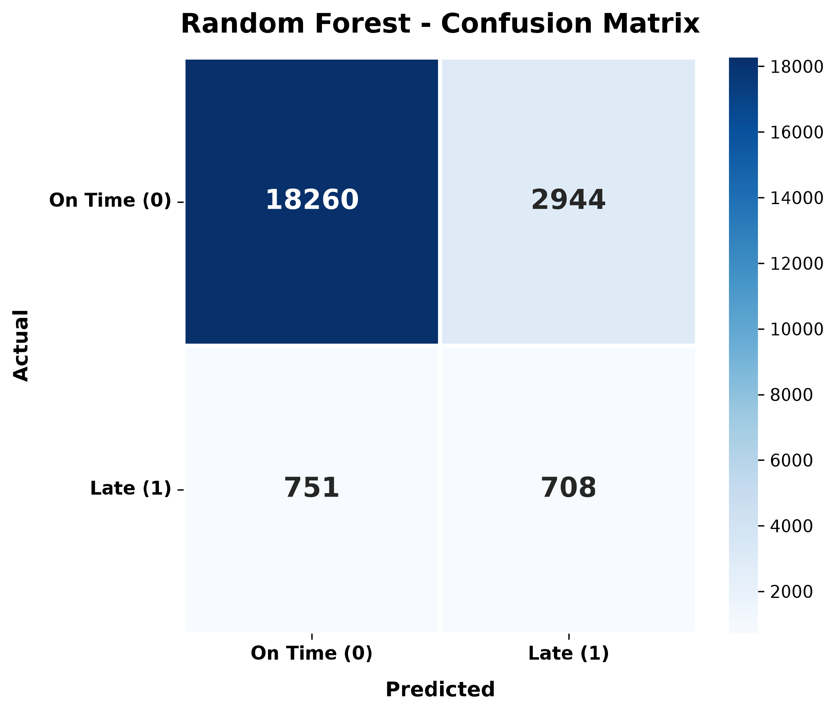
SELECTED MODEL · HELD-OUT TEST SET
PRESENTER 5
Confusion Matrix
18,260
2,944
True Negatives
False Positives
On-time, correctly predicted on-time
On-time orders flagged as late
751
708
False Negatives
True Positives
Late orders the model missed
Late orders correctly caught
On the test set: ~83.7% accuracy, 19.4% precision, 48.5% recall, 27.7% F1. Focus for the business: the 751 False Negatives are late deliveries the model didn't flag in advance.
Confusion Matrix
15
Notes:
Explain the confusion matrix for the final tuned Random Forest on the untouched test set. Walk through True Negatives, False Positives, False Negatives, and True Positives in plain terms, and stress that the 751 False Negatives are the late orders the model still misses — the main area for future improvement.

Slide 24
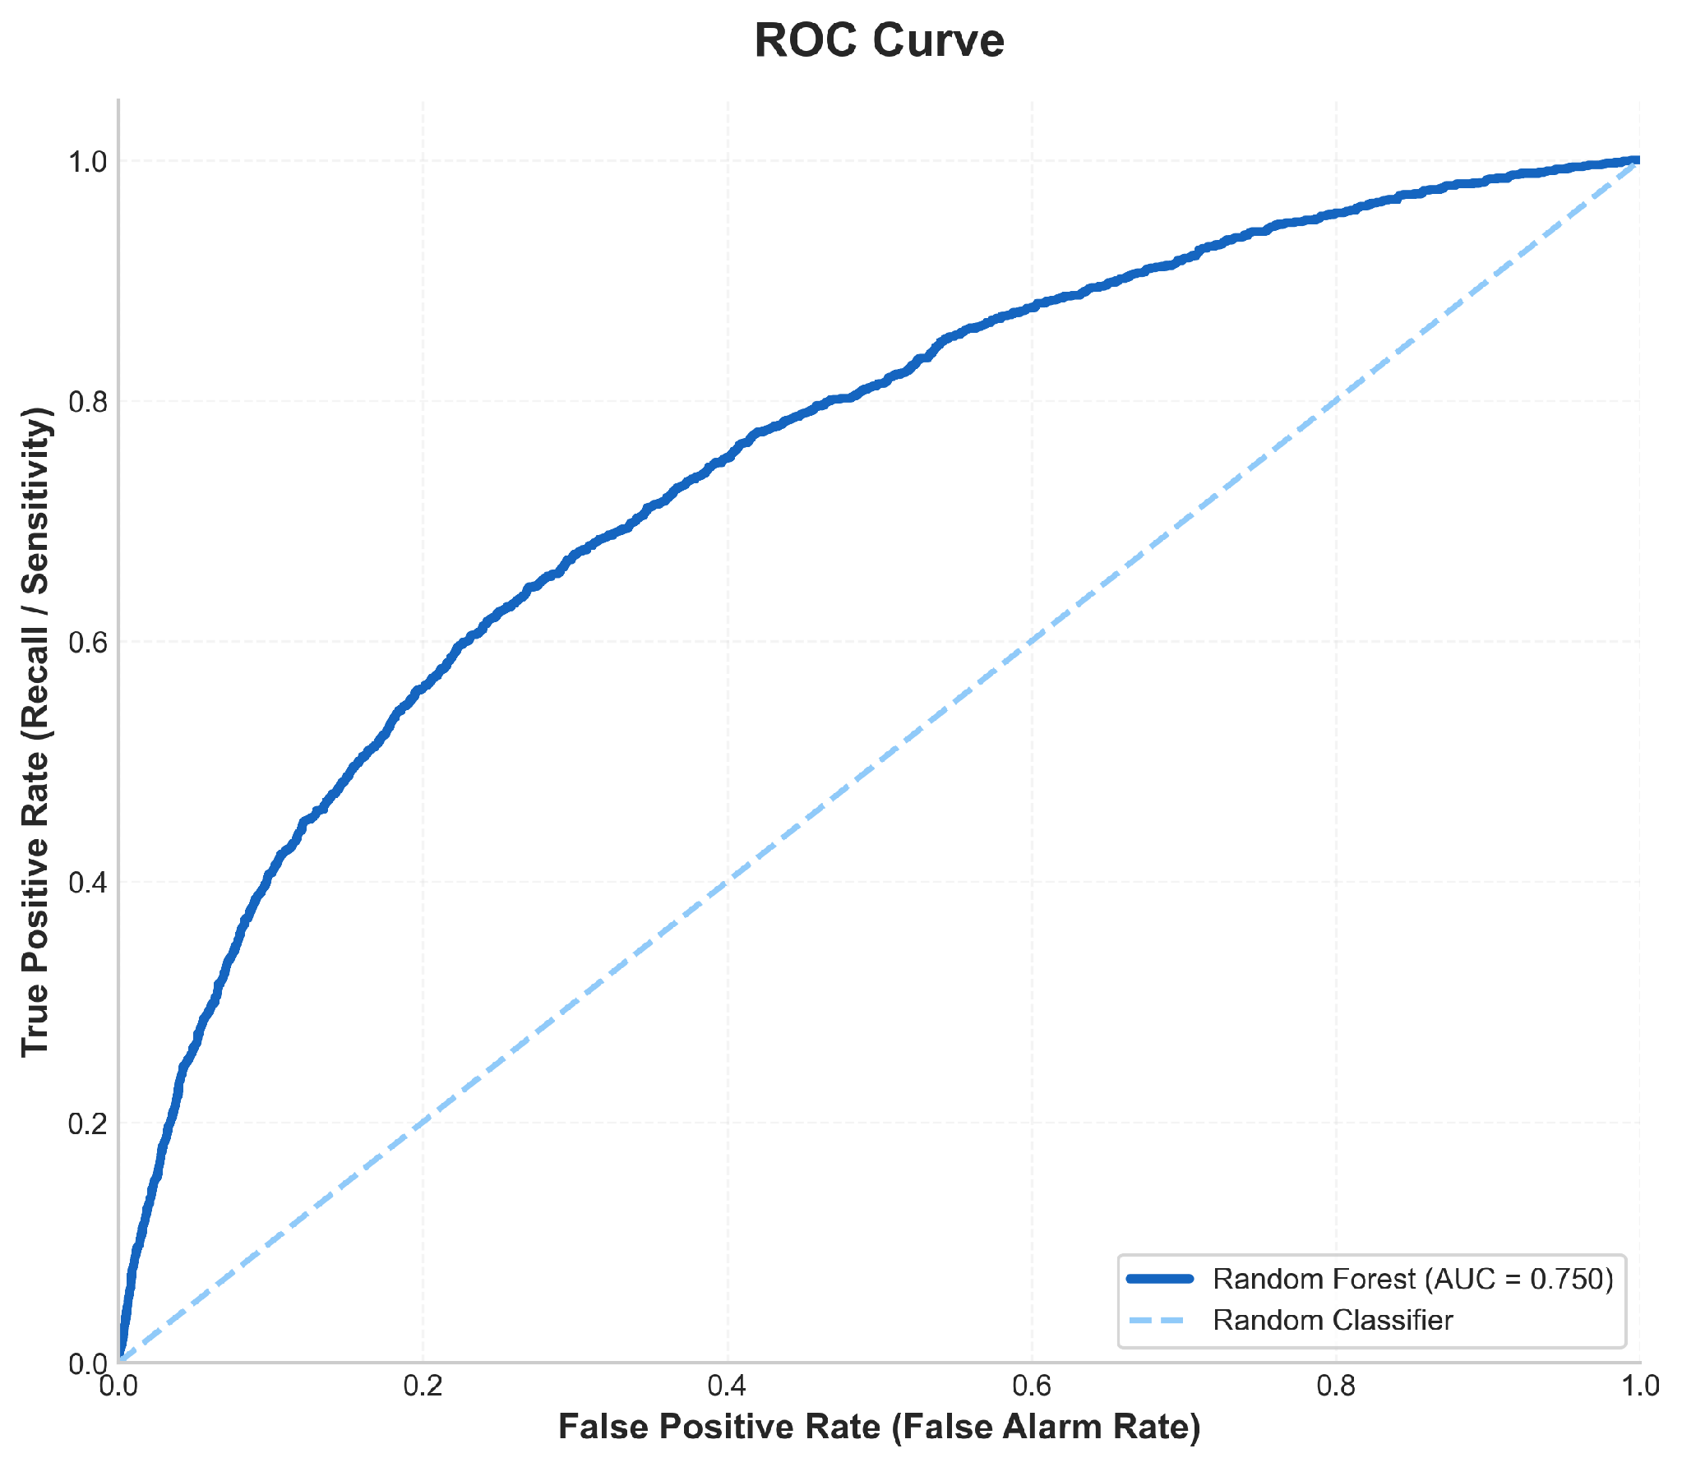
SELECTED MODEL · HELD-OUT TEST SET
PRESENTER 5
ROC Curve
0.750
ROC-AUC score
Well above the 0.5 random-classifier baseline (dashed line), showing real ability to separate late from on-time orders.
The curve rises steeply at low false-positive rates — the model ranks many true late orders highly with few false alarms.
ROC Curve
16
Notes:
Show the ROC curve and call out the AUC of 0.750, well above the random-classifier baseline. Explain in one sentence what the curve shape says about the model's ability to separate late from on-time orders.

Slide 25
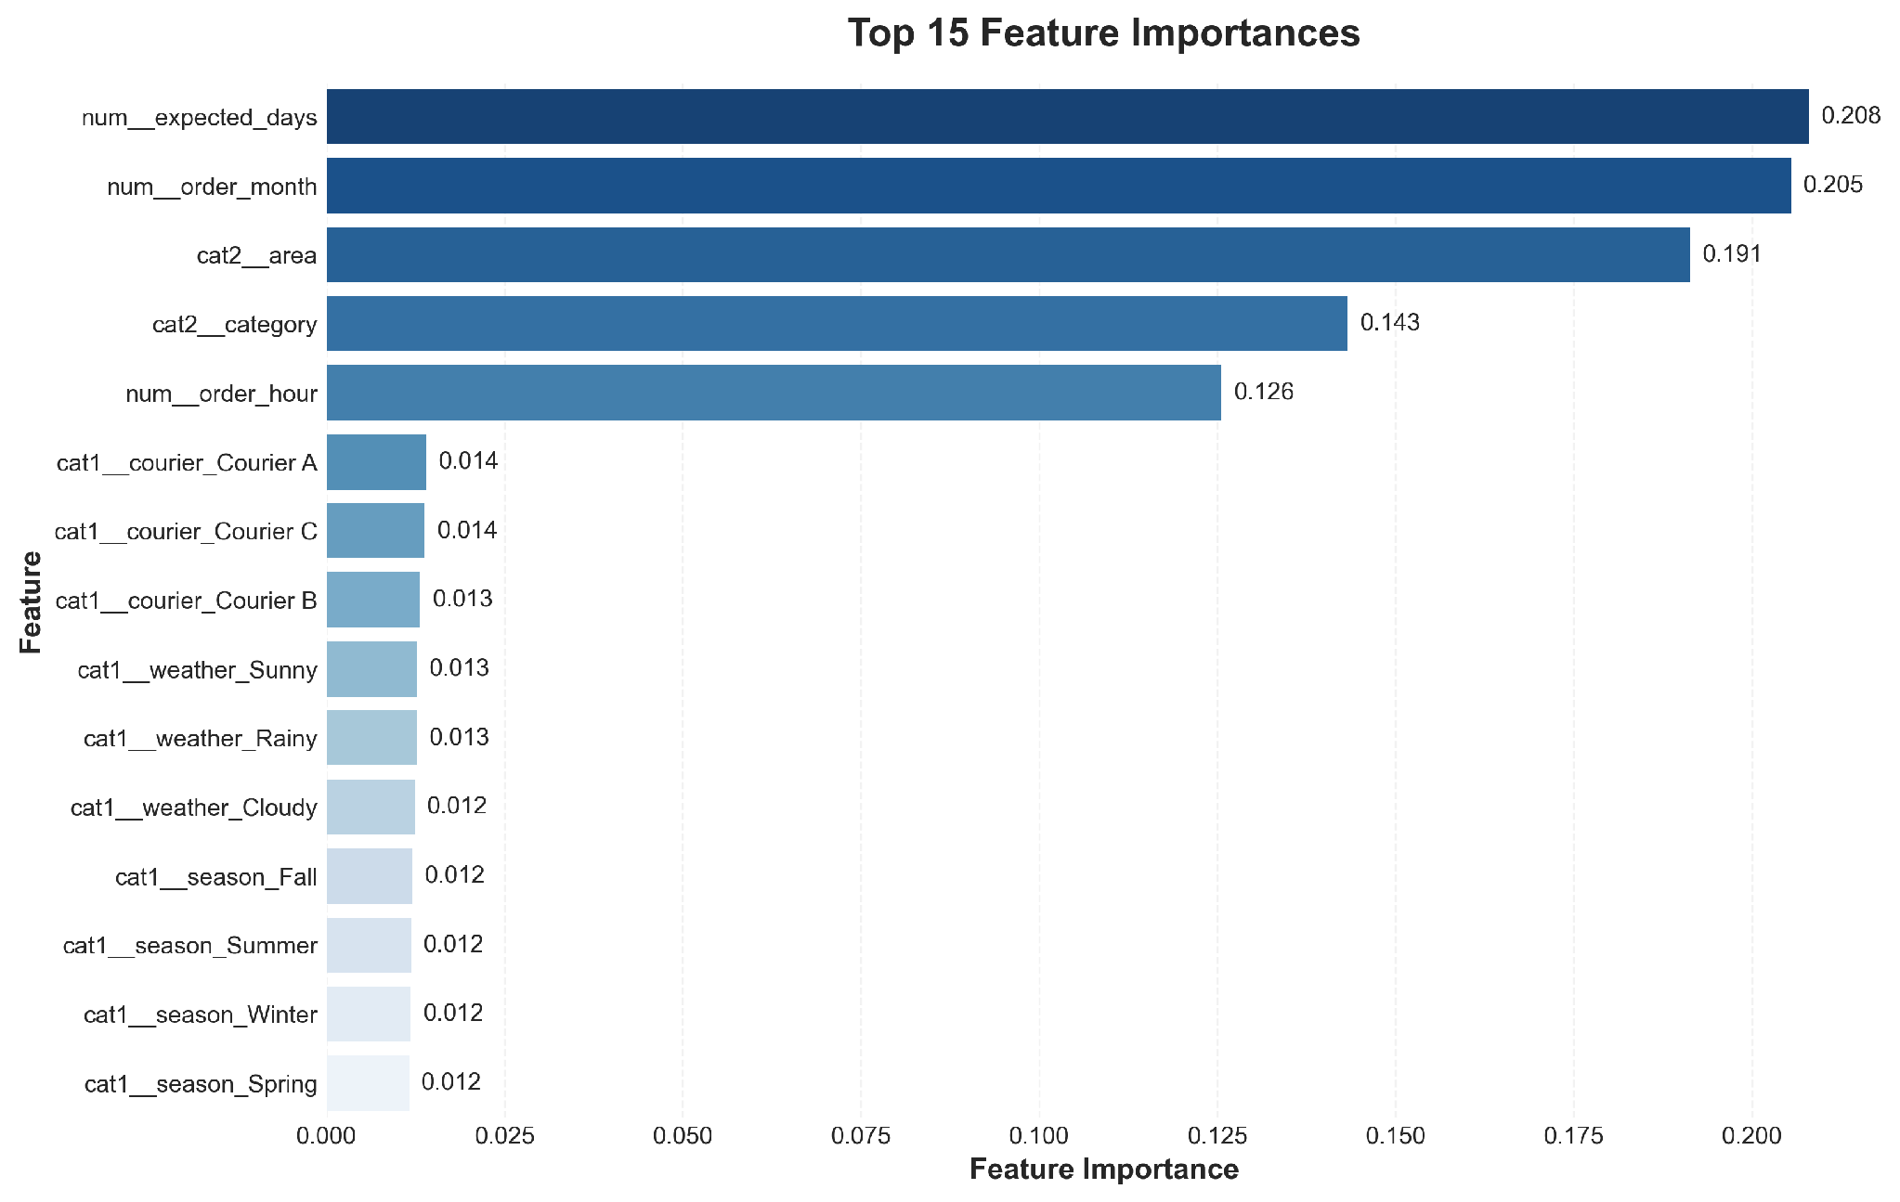
WHAT DRIVES THE PREDICTION
PRESENTER 5
Feature Importance
Top drivers
expected_days
0.208
order_month
0.205
area
0.191
category
0.143
order_hour
0.126
These 5 features account for the large majority of the model's importance; courier, weather, and season features each contribute a smaller, more even share.
Feature Importance
17
Notes:
Walk through the top 5 features by importance — expected_days, order_month, area, category, and order_hour dominate, while courier, weather, and season contribute smaller, more even amounts. This sets up the business insights slide.

Slide 26
FROM MODEL TO DECISIONS
PRESENTER 5
Business Insights & Recommendations
Early Delay Detection
Expected Delivery Time
Monthly Patterns
1
2
3
INSIGHT
INSIGHT
INSIGHT
The model predicts whether an order is likely to be delivered late.
Expected Days is the most important feature, with 20.8% importance.
Order Month is one of the strongest predictors, with 20.5% importance.
RECOMMENDATION
RECOMMENDATION
RECOMMENDATION
Use predictions to identify potentially delayed orders early.
Improve estimated delivery times using historical delivery patterns.
Prepare additional logistics capacity during higher-risk periods.
Business Insights & Recommendations
18
Notes:
First set of insight-and-recommendation cards: the model flags likely-late orders early; Expected Days is the top predictor at 20.8% importance; Order Month is nearly as important at 20.5%. Each insight is paired with a concrete action the business can take.

Slide 27
FROM MODEL TO DECISIONS
PRESENTER 5
Business Insights & Recommendations
Geographic Risk
Weather Impact
Model Performance
4
5
6
INSIGHT
INSIGHT
INSIGHT
Area has a strong influence on delay predictions, with 19.1% importance.
Weather is included as a prediction feature, but its importance in the current model is limited.
Random Forest achieved a ROC-AUC of 0.750, showing good ability to distinguish late and on-time orders.
RECOMMENDATION
RECOMMENDATION
RECOMMENDATION
Optimize delivery planning and resources across different areas.
Evaluate weather impact further using more detailed and reliable weather data.
Use the model as a decision-support tool for delivery planning.
Business Insights & Recommendations
19
Notes:
Second set of cards: Area is a strong geographic predictor at 19.1% importance, Weather is included but currently has limited importance so it's worth revisiting with richer data, and the selected Random Forest model reached an ROC-AUC of 0.750 — meaning it reliably ranks late orders above on-time ones. Position it as a decision-support tool, not a fully automated one.

Slide 28
WRAPPING UP
PRESENTER 5
Conclusion & Final Output
Project Achievement
Model Comparison
Built a Machine Learning system to predict delivery delays before they occur.
Compared 7 classification models using: Accuracy, Precision, Recall, F1-Score & ROC-AUC.
FINAL MODEL
FINAL OUTPUTS
Random Forest
✓
Model Comparison
✓
Confusion Matrix
✓
ROC Curve
✓
Feature Importance
Accuracy=83.7
✓
Business Insights & Recommendations
✓
Final .pkl Model
Conclusion & Final Output
20
Notes:
Close with the summary: what was built, that 7 models were compared across Accuracy/Precision/Recall/F1/ROC-AUC, that Random Forest was selected as the final model with ROC-AUC 0.750, and the concrete list of project deliverables. Thank the audience and open for questions.

Slide 29
Thank you
20
Notes:
Wrap up: summarize what was built, what it achieved (ROC-AUC 0.750), and why it's useful. End on the takeaway line — prediction here is about surfacing risk early, not achieving perfect accuracy. Thank the audience and open for questions.

